Slide 1
Summary Report for BFX–UA300
Quality Issue on June-2022 Product.
Prepared by: Rachel Ruan
Reviewed by: Toney Tu
Approved by: CB Lin
Date: 2022-Sep-16

Slide 2
Issue Description
08-Sep-2022, ALT customer complain [BFX-UA300] 2022.June Mass production issue.
Sampling size code : L -> M (316pcs), AQL 0.15
Defect Total:
Critical
NA
Major
1. BTV logo plate is missing * 1pcs
2. Tact switch feeling NG*2pcs
3. Woofer speaker output NG * 1pcs
Minor
1. Manual printing NG * 1pcs
2. HDMI cable cosmetic NG*6pcs

Slide 3
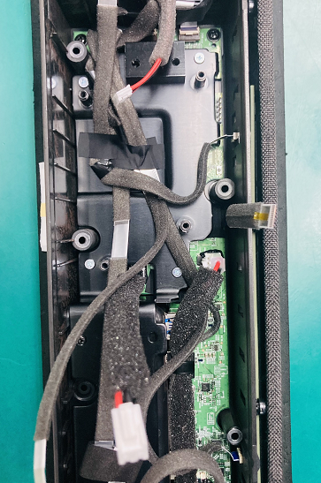
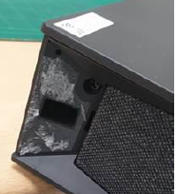
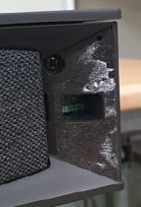
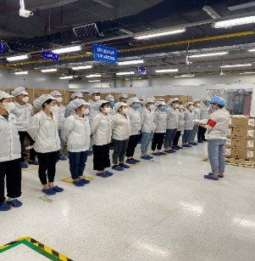

1. BTV logo plate missing
Issue Description | Root Cause | Actions | Status
Symptom: BTV logo plate missing Type: Major Defect unit Q’ty : 1/316pcs Defect rate : 0.031% SKB SN: 2149695001202201014628 ALT initial review • Visual check : found abnormal. This STB was disassembled from factory. | Check the data this production on 15-June-2022, that time we defect TOP housing incoming after assembly have button jam issue. ( DC housing Dec-2021 ). Fii had inform to ALT customer and Inkel vendor about button jam issue before. Check SFIS data found this SN had disassembled cause by on VI check button abnormal ( jam button issue ). Fii rework TOP case for repair button jam issue. Visual inspection OP check no find out defect issue. | 1. Inkel vendor had provide add gasket on assembly housing cover button jam issue. Status : Done 2. From July-2022 to now we no defect more button jam issue on production line. Status : Done 3. Add missing BTV logo picture to SOP, and training all OP online the ALT customer high light cosmetic issue. | Monitor

Slide 4
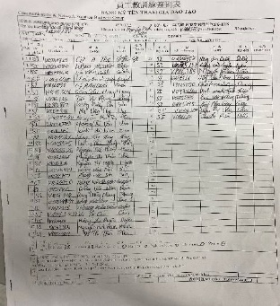

2. Tact feeling is not good
Issue Description | Root Cause | Actions | Status
Symptom : tact feeling is NG Type: Minor Defect unit Q’ty : 2 / 316pcs Defect rate : 0.063% S/N : 2149695001202201013314, 2149695001202201013016 ALT initial review • Visual check : found abnormal. This STB was disassembled from factory. | Check the data this production on 15-June-2022, that time we defect TOP housing incoming after assembly have button jam issue. ( DC housing Dec-2021 ). Fii had inform to ALT customer and Inkel vendor about button jam issue before. Check SFIS data found this SN had disassembled cause by on VI check button abnormal ( jam button issue ). Fii rework TOP case for repair button jam issue. Check Log test data, button function test is pass normal. | 1. Inkel vendor had provide add gasket on assembly housing cover button jam issue. Status : Done 2. From July-2022 to now we no defect more button jam issue on production line. Status : Done 3. Before run line , line leader training OP, notice quality online issue, IPQC defect issue, OBA issue, read SOP and quality alarm. Status : Done | Monitor

Slide 5
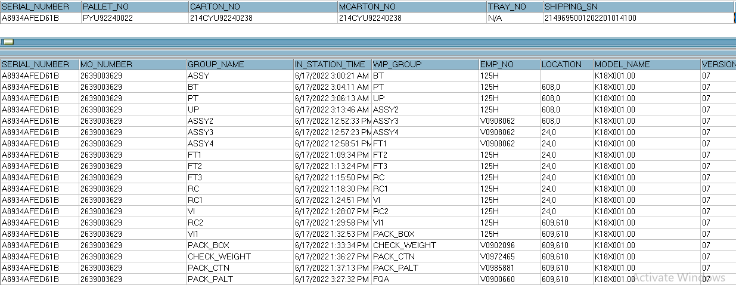
3. Woofer Speaker Output NG
Issue Description | FA | Root cause | Actions | Status
Symptom: Noise with speaker output Type: Major Defect unit Q’ty : 1/316pcs Defect rate : 0.31% SKB SN: 2149695001202201014100 ALT initial review • Visual check : No found abnormal. • Function check : Noise is heard at low volume at Right woofer. | 1. Fail symptom: As ALT feedback that they found out 1pcs Noise with speaker output (Noise is heard at low volume at Right woofer). 2. Check FATP data On FATP : Check test data no find out abnormally 3. Suggestion: - Take X-ray right woofer - Swap NG unit to OK product ( Right woofer connected with 96.1531T00 AMP board ) + If swap result is OK ➔ Re-assembly NG right woofer to the original product + If swap result is NG ➔ This issue follow material | Waiting NG speaker sample for more analysis. |  | Monitor

Slide 6
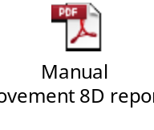
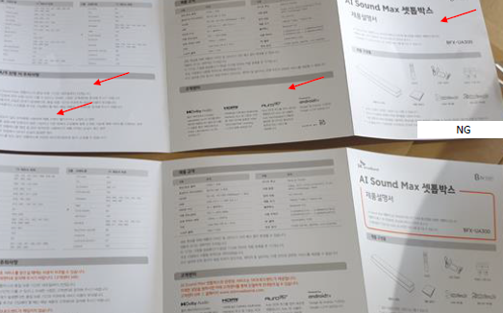

4. Manual printing NG - Orange color printing is missing
Issue Description | Root Caue | Action | Status
Symptom: BTV logo plate missing Type: Minor Defect unit Q’ty : 4/316pcs Defect rate : 1.26% ALT initial review • Visual check : found abnormal. One color printing is missing | 1. Manual incoming cosmetic issue, Fii feedback to Goldsun vendor and request 8D report to Goldsun Quality team . Due date: 16-Sep-2022 2. IQC OP no defect this issue when checking incoming material manual. 3. Online product no check accessory cosmetic , OBA check accessory follow AQL 0.65, no defect this issue. | Return all manual in Fii stock back vendor for sorting missing printing orange color. Qty 1460 pcs. And vendor sorting no defect fail issue. Status: Done 2. Hang quality alarm on IQC control housing incoming this issue, if IQC defect, will reject housing back vendor. 3. Add to IQC-SIP checking manual cosmetic the NG picture. Status: Done 4. Hang quality alarm at OBA station for OP doing notice it. Status : Done. 5. Add to SIP OBA check cosmetic and function manual ( accessory checking ). Status : Done. | Monitor

Slide 7
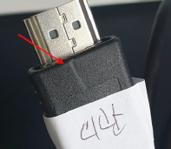
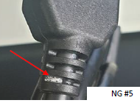

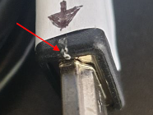
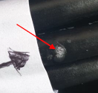
5. HDMI cable cosmetic NG
Issue Description | Root Cause | Actions | Status
Symptom : HDMI Cosmetic issue Type: Minor Defect unit Q’ty : 6/316pcs Defect rate : 1.9% ALT initial review • Visual check : found cosmetic abnormal. | 1. HDMI incoming cosmetic issue, Fii feedback to FIT vendor and request 8D report to FIT Quality team . Done: 15-Sep-2022 2. IQC OP no defect this issue when checking HDMI incoming material. 3. Online product no check accessory cosmetic , OBA check accessory follow AQL 0.65, no defect this issue. | Hang quality alarm on IQC control housing incoming this issue, if IQC defect, will reject housing back vendor. Add to IQC-SIP checking HDMI cosmetic the NG picture. Status: Done Hang quality alarm at OBA station for OP doing notice it. Status : Done. 2. Add to SIP OBA check cosmetic and function HDMI ( accessory checking ). Status : Done. | Done

